Slide 1
KNN Classifier
K-Nearest Neighbors (KNN) classifies new data points based on the majority class among their k-nearest neighbors, using distance metrics like Euclidean distance.
Its effectiveness depends on 'k' and is suitable for specific datasets, but computationally demanding for larger ones.
It finds applications in recommendation systems and medical diagnosis, being a non-parametric, lazy algorithm that defers model building until prediction.
https://www.youtube.com/watch?v=Vk9lGGODaJA

Slide 2
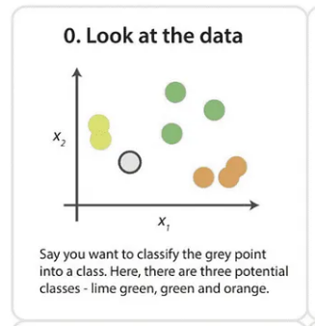
Example

Slide 3
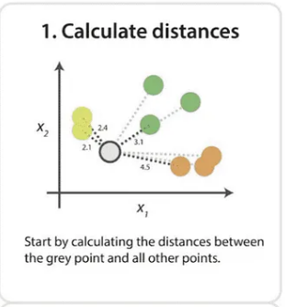

Slide 4
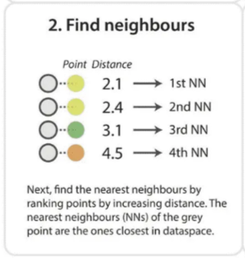

Slide 5
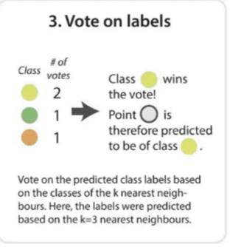

Slide 6
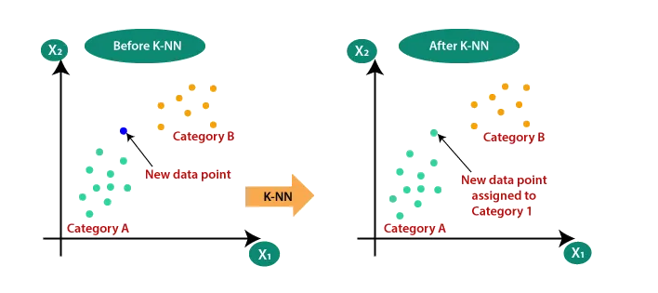
Suppose there are two categories, i.e., Category A and category B, and we have a new data point x1, so this data point will lie in which of these categories. To solve this type of problem, we need a K-NN algorithm. With the help of K-NN, we can easily identify the category or class of a particular dataset. Consider the below diagram:

Slide 7
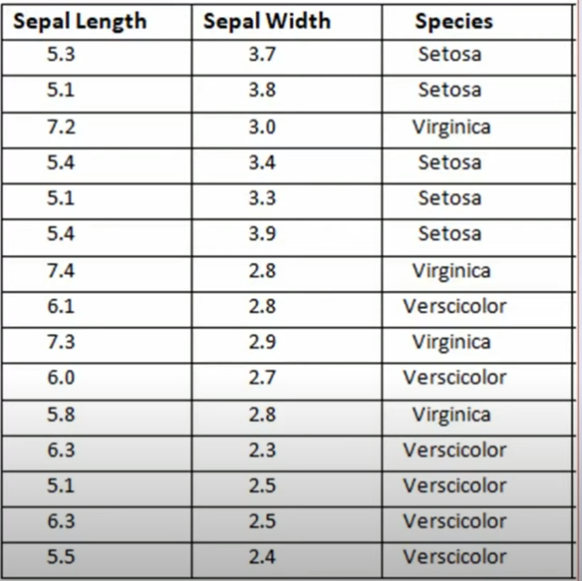





Slide 8

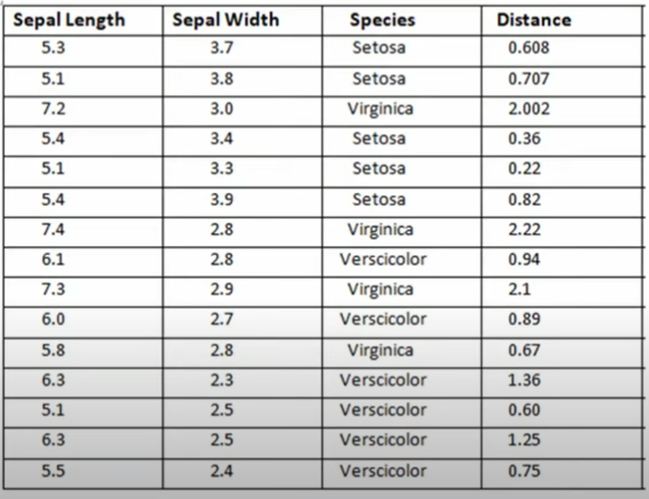
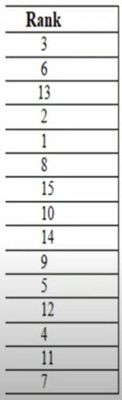
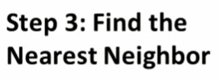




Slide 9
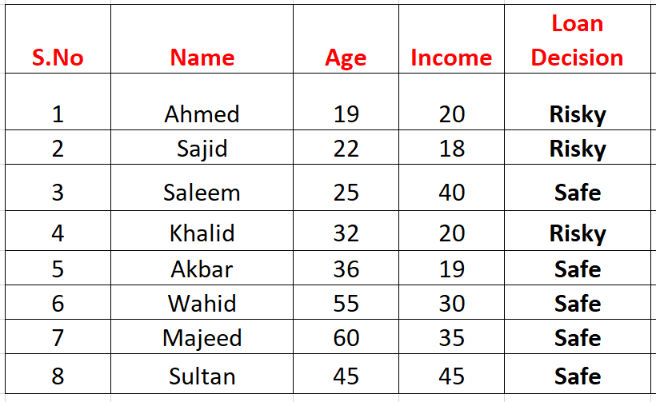
DO IT YOURSELF NOW
Mr. Javed Ahmed has applied for loan. His age is 34 and income is 45 K. Being an analyst you are required to asses this case for loan whether he may be sanctioned loan or not.
https://www.saedsayad.com/naive_bayesian.htm

Slide 10
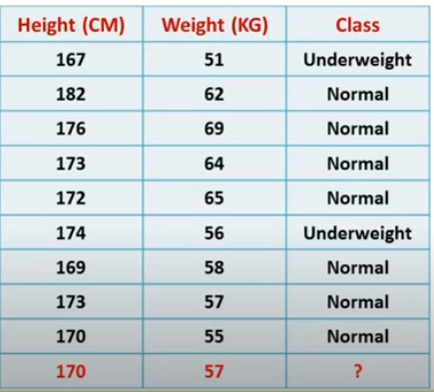
DO IT YOURSELF NOW
https://www.youtube.com/watch?v=HZT0lxD5h6k

